Slide 1

COIT11241 CyberSecurity Technologies
Assignment 2
Topic: Attack
Identify vulnerabilities.
Student ID: 12230757
name: anil Budthapa
Satrt date :27 April 2024
Due date: 11 may 2024, 8:59 AM

Slide 2
HOST Details
Name : win2022
IP Add: 192.168.56.50
Vulnerable file : coit11241/office_2019.exe at main · jamieshield/coit11241 · GitHub

Slide 3
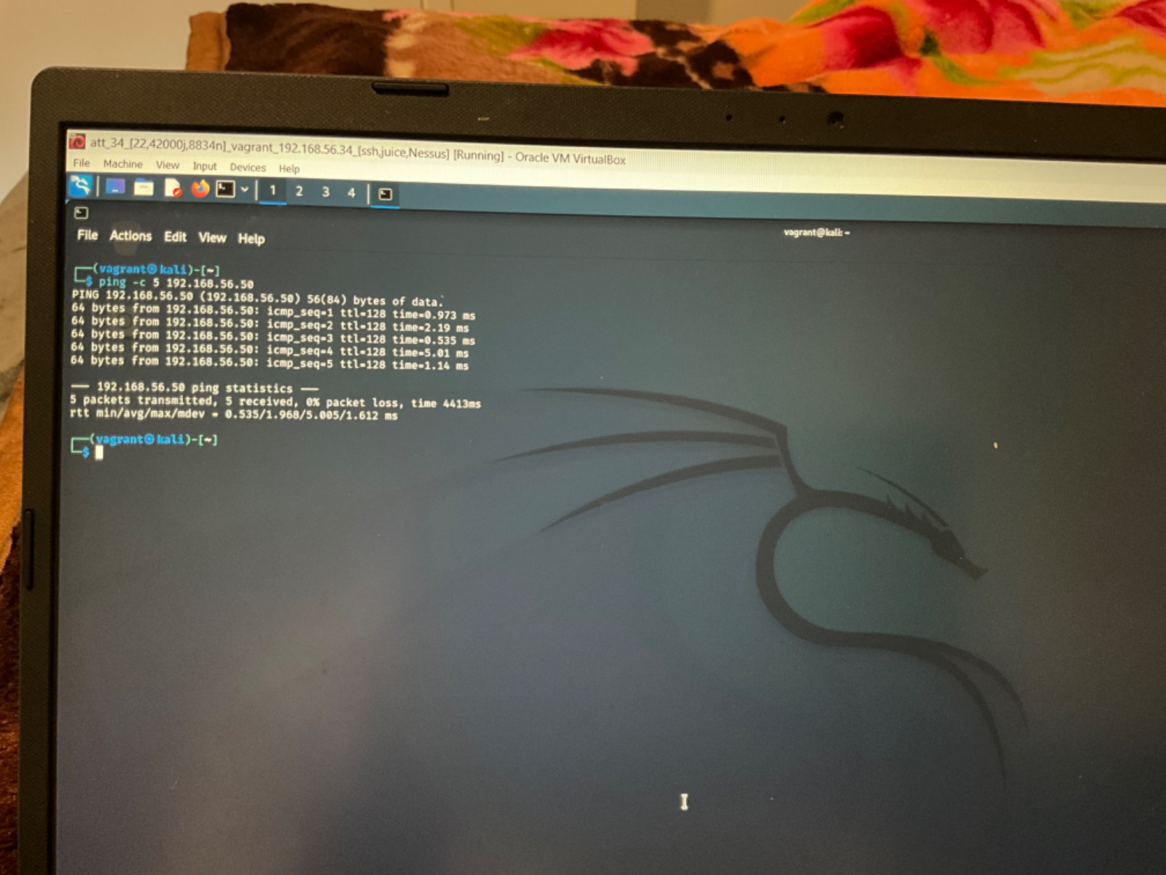
Host status
Ping –c 5 192.168.56.50

Slide 4
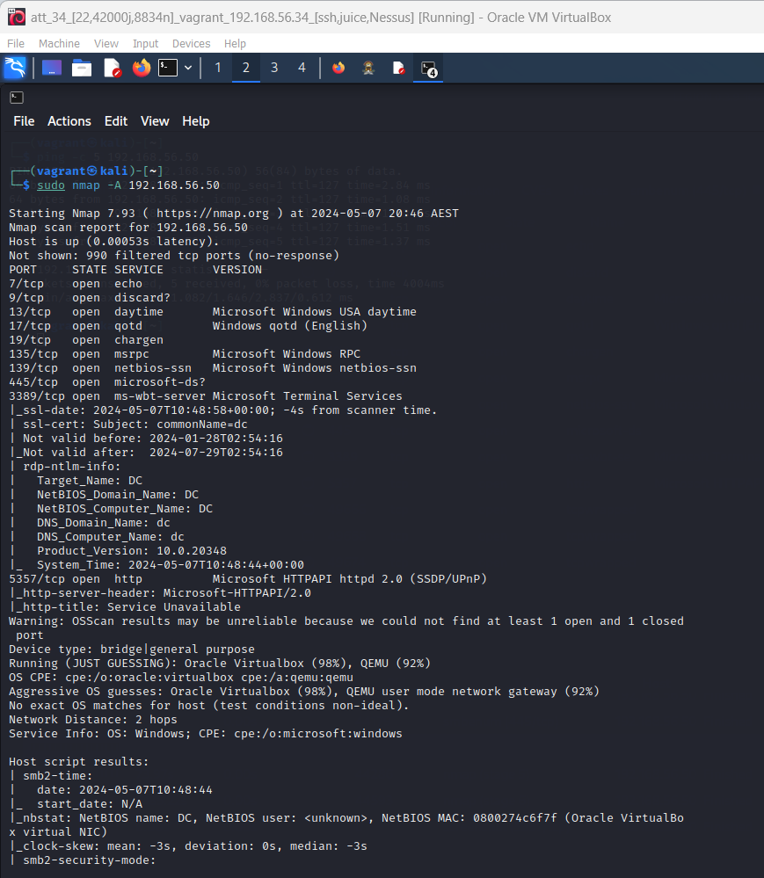
Information Gathering
Nmap
Nmap –A 192.168.56.50
All other info in github –
GitHub link

Slide 5
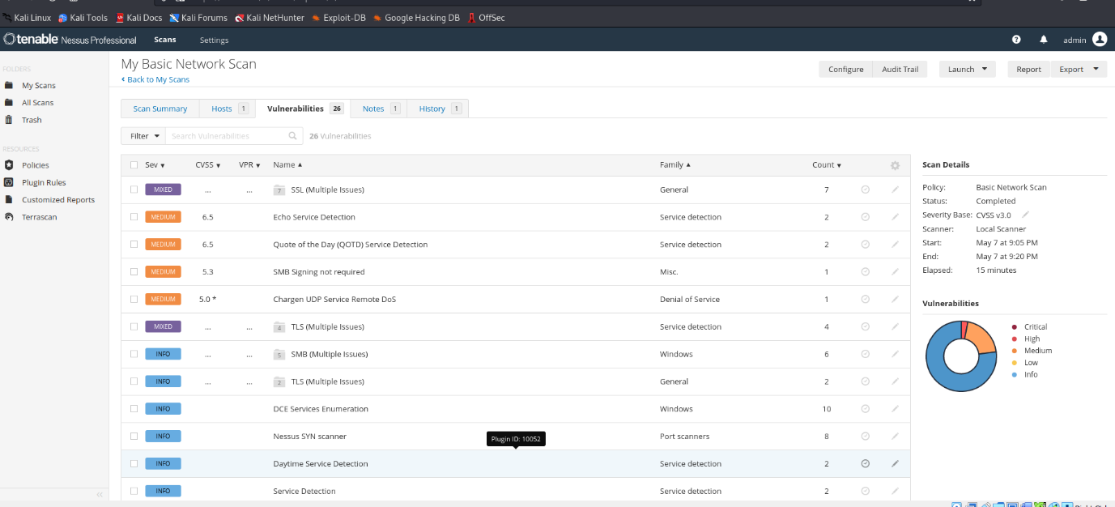
Vulnerabilities Gathering
Nessus
GitHub Link

Slide 6
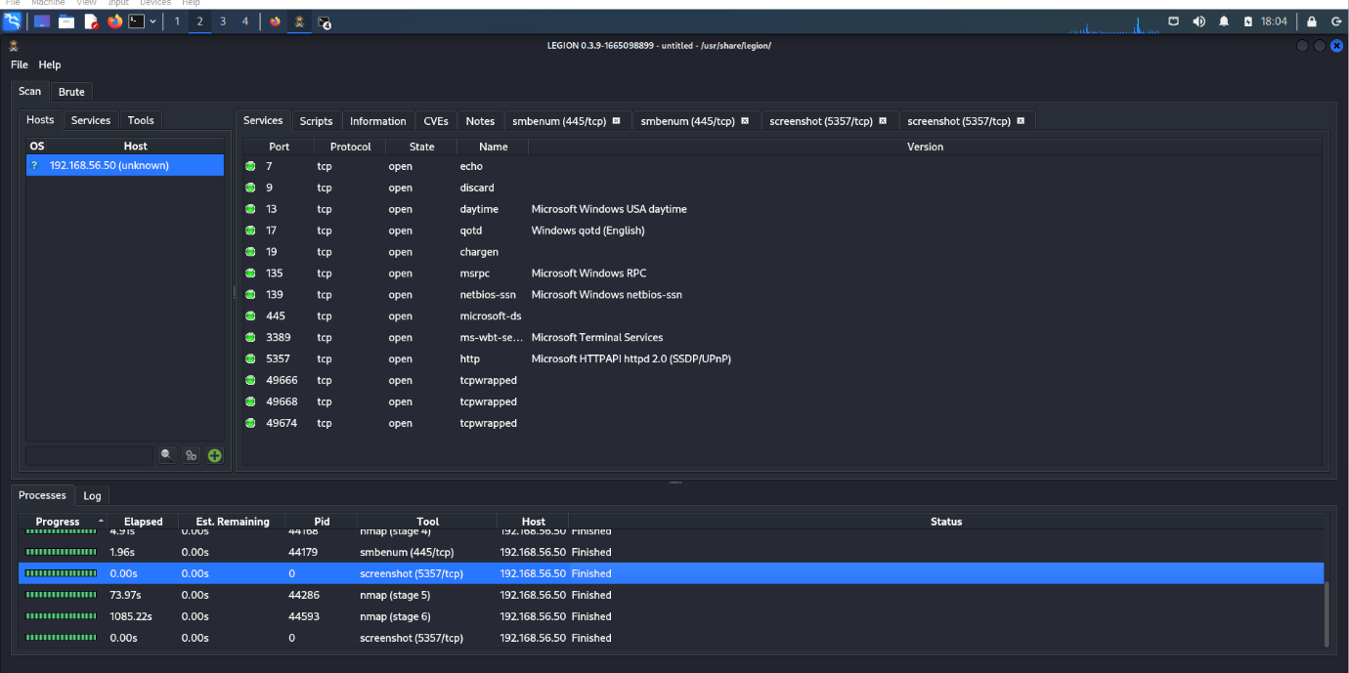
Legion (root)
Github link

Slide 7
Top 5 ATT&CK Codes:
Reconnaissance (T1590):
  Identify vulnerabilities within network infrastructure
  Enhance detection and response mechanisms
Credential Access (T1110):
  Escalate privileges and move laterally within network
  Strengthen password policies and implement MFA
Execution (T1059):
  Execute malicious payloads across network
  Deploy EDR solutions for monitoring and blocking
Defense Evasion (T1562):
  Employ tactics to evade detection by security controls
  Implement behavior-based detection mechanisms
Impact (T1486):
  Disrupt operations and extort ransom payments
  Implement robust data backup strategies and incident response plans

Slide 8
Medusa lifecycle
Medusa’s main aim is to steal the credentials from the victim host. Medusa achieves this aim by (1) Gathering information by using various Sub techniques of reconnaissance ATT&CK ID: T1590 : T1590.001, T1590.002, T1590.003, T1590.004, T1590.005, T1590.006 where they do Active Scanning or Phishing for Information by this way it gain initial access then it (2) brute force . Credential Access (ATT&CK ID: T1110): using this
Sub-techniques: T1110.001, T1110.002, T1110.003, T1110.004 to get credential data as we did in task 1. After this (3) Execution (ATT&CK ID: T1059): take place by using
Sub-techniques: T1059.001, T1059.002, T1059.003, T1059.004, T1059.005, T1059.006, T1059.007, T1059.008, T1059.009, T1059.010 which help in execution of file through remote access then (4) it will do Defense Evasion (ATT&CK ID: T1562): to bypass the security of host. It also use various
Sub-techniques: T1562.001, T1562.002, T1562.003, T1562.004, T1562.006, T1562.007, T1562.008, T1562.009, T1562.010, T1562.011, T1562.012 then (5) the impact Impact (ATT&CK ID: T1486): Of this attack is downtime, financial losses, and reputational damage.
Medusa’s initial access technique: T1590.002 Gather Victim Network Information: Domain Properties via Active scanning like WHOIS .
Now, try to get credential access with T1110.001 - Brute Force: Password Guessing which use wide range of password like passwdlist.
Now Command and Scripting Interpreter: AppleScript take place which is execution process with processID: T1059.002 .
Then bypass the host security with sub technique: T1562.002 Impair Defenses: Disable or Modify Tools which may take many forms, such as killing security software processes or services, modifying / deleting Registry keys or configuration files so that tools do not operate properly, or other methods to interfere with security tools scanning or reporting information. Adversaries may also disable updates to prevent the latest security patches from reaching tools on victim systems.
At last company have to face various consequences such as it encrypts data on target systems or on large numbers of systems in a network to interrupt availability to system and network resources. They can attempt to render stored data inaccessible by encrypting files or data on local and remote drives and withholding access to a decryption key.

Slide 9
Analysis of likelihood of CVE exploitation by Medusa
CVE-2017-0144 wannacry ransome with pattern EternalBlue is a remote code execution vulnerability
CWE | CAPEC | ATT&CK | Used by BumbleBee
200 | 165 Connection Proxy | Connection Proxy, Technique T0884 - ICS | yes
 | 100 Exploitation of Authentication Vulnerability | Exploitation for Credential Access, Technique T1212 - Enterprise | yes
 | 121 Command Injection | Exploitation of Remote Services, Technique T1210 - Enterprise | yes
 |  | OS Credential Dumping, Technique T1003 - Enterprise | yes
 |  | Defense Evasion, Tactic TA0005 - Enterprise | yes
 |  | Execution, Tactic TA0002 - Enterprise | yes
 |  | Impact, Tactic TA0040 - Enterprise | yes

Slide 10
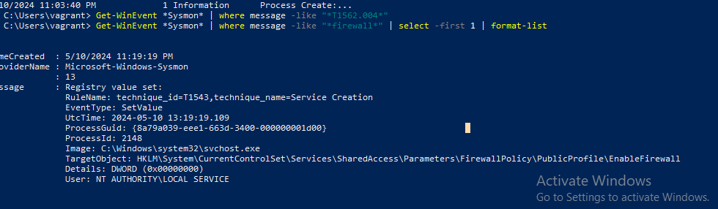
Emulate Attack
Attack 1. T1562.004 Disable Microsoft Firewall.
Attack command: Run with PowerShell or make script and execute in PowerShell
C:/ netsh advfirewall set currentprofile state off
Monitoring the attack through Sysmon
C:/Get-WinEvent *Sysmon* |where message -like “* firewall *” | Select -first 1 | format-list

Slide 11
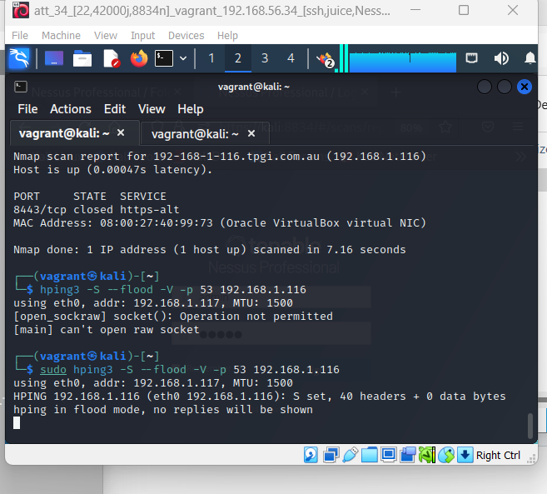
Attack 2
T1498.001 Direct Network Flood
from kali machine udp flooding that lead to ddos from udp smb signing not required.
root@kali: hping3 -S –flood -V -p 53 192.168.56.50
result : overflow of packet .
impact : slow your pc or stuck and use different

Slide 12
Reference
Atomic RED team, Accessed 7 May 2024, https://atomicredteam.io/
Mitre, Accessed 8 May 2024, https://attack.mitre.org/

